Slide 1
Chain of Responsibility Design Pattern
Team 1
Srichakradhar Reddy Nagireddy
Pavan Kumar Yannamaneni
Sathwik Banginimatam
Ravindra Reddy Chennapareddy

Slide 2
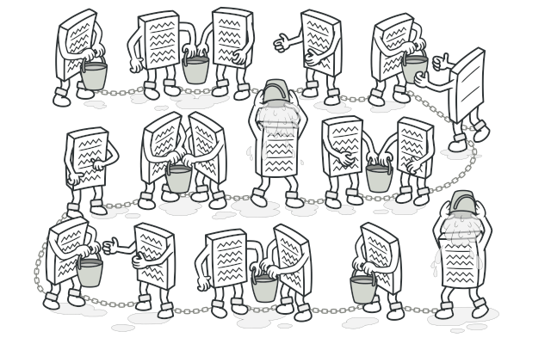
What it is ?
Chain of Responsibility is a behavioral design pattern that lets us pass requests along a chain of handlers.
Each handler decides either to process the request or to pass it to the next handler in the chain.

Slide 3
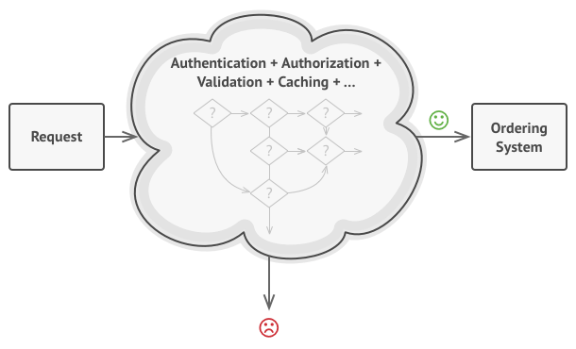
Why It is?
In normal design pattern, all the requests are handled within a single handler
System becomes more and more bloated as we added each new feature

Slide 4
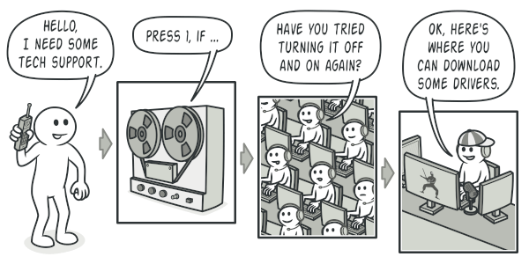
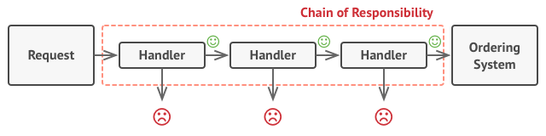
Solution
Relies on transforming particular behaviors into stand-alone objects called handlers
Each check will be extracted to its own class with a single method

Slide 5
When to use ?
When you want to decouple a request’s sender and receiver
Multiple objects, determined at runtime, are candidates to handle a request
When you don’t want to specify handlers explicitly in your code
When you want to issue a request to one of several objects without specifying the receiver explicitly.
Define a chain of receiver objects having the responsibility, depending on run-time conditions, to either handle a request or forward it to the next receiver on the chain

Slide 6
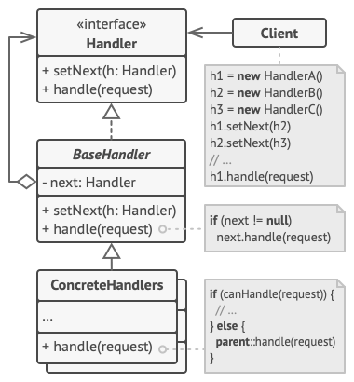
Structure
The Handler declares the interface, common for all concrete handlers.
The Base Handler is an optional class where we can put the boilerplate code that’s common to all handler classes.
Concrete Handlers contain the actual code for processing requests.
The Client may compose chains just once or compose them dynamically, depending on the application’s logic

Slide 7
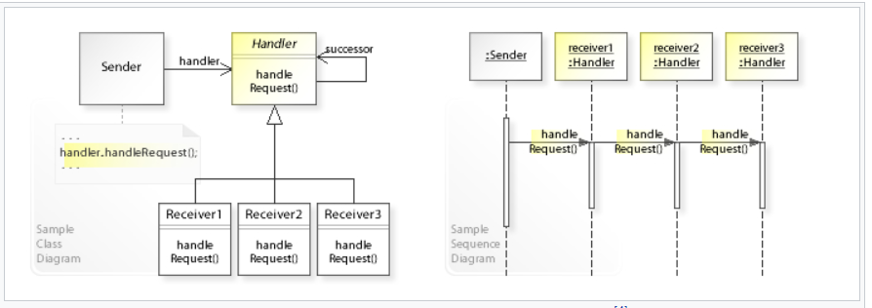
UML Diagram

Slide 8
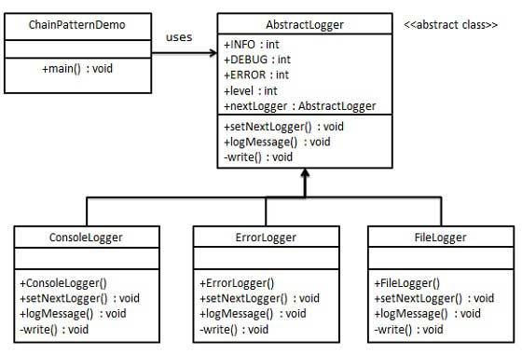
Implementation
An abstract class AbstractLogger with a level of logging.
Three types of loggers extending the AbstractLogger.
Each logger checks the level of message to its level.

Slide 9
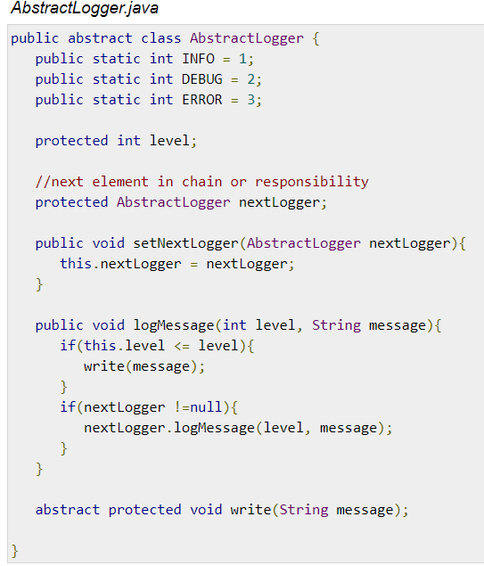
Code
Step 1: Create an abstract logger class.

Slide 10
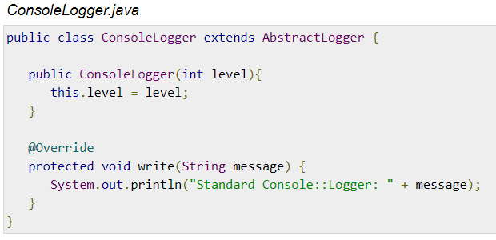
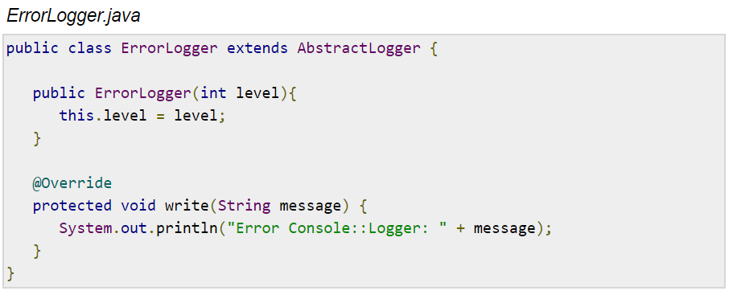
Step 2: Create concrete classes extending the logger.

Slide 11
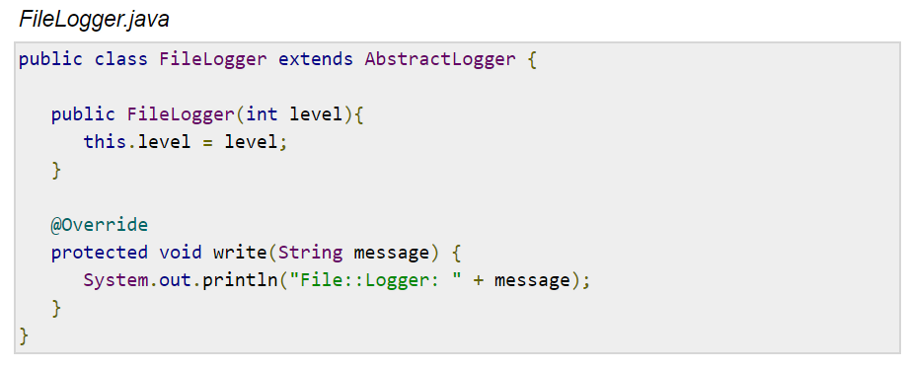
Step 2: Create concrete classes extending the logger.

Slide 12
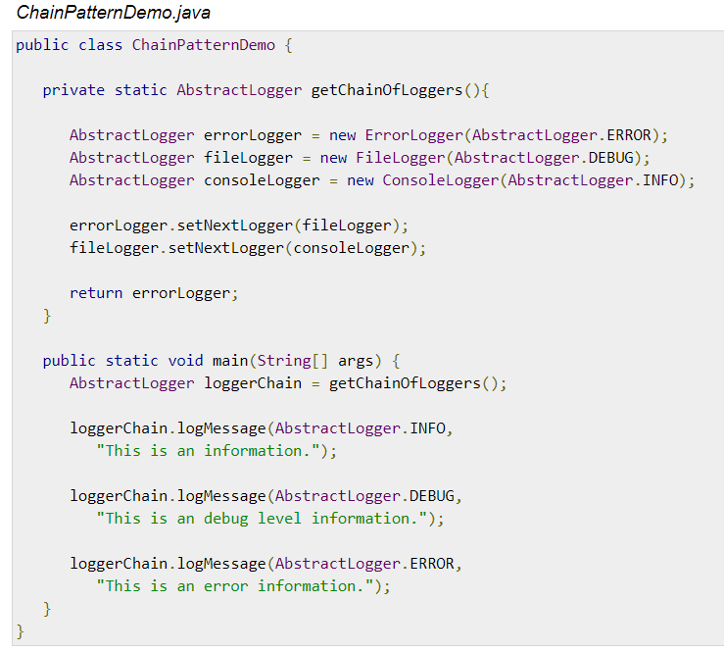
Step 3: Create different types of loggers. Assign them error levels and set next logger in each logger. Next logger in each logger represents the part of the chain.

Slide 13
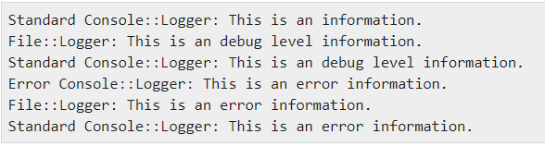
Step 4: Verify the output

Slide 14
Quiz
1.When to use Chain of Responsibility pattern ?
When our program is expected to process different kinds of requests in various ways, but the exact types of requests and their sequences are unknown beforehand
2.Can we control order of request handling in COR?
True
False
3.Chain of Responsibility is a kind of which design pattern?
A) Creational
B) Structural
C) Behavioral

Slide 15
THANK YOU

